Slide 1
Capita 5 from sound to hearing
15 juni 2016
Cris Lanting
c.p.lanting@umcg.nl

Slide 2
After this capita
You should be able to
name different parts of the ear, name and explain their function
Explain the transduction from sound to action potentials
Explain how bone-conduction may help rehabilitation
Explain how the size and shape of an organism affects their sensitivity to sound (and vocalizations)
How objective measurements can be used to diagnose hearing
What types of rehabilitation exist and how they work

Slide 3
Outline
Part 1. Sound and acoustics
How we measure and perceive sound; levels & loudness
Part 2. The ear
Outer ear, middle ear and inner ear
Anatomy, function and mechanism
Part 3. Diagnostic testing and rehabilitation

Slide 4
Sound and acoustics
Part 1.

Slide 5
Question
What sound pressure level does the loudest possible sound on earth have?
A. 120 dB SPL
B. 170 dB SPL
C. 193 dB SPL
D. 210 dB SPL
E. 213 dB SPL

Slide 6
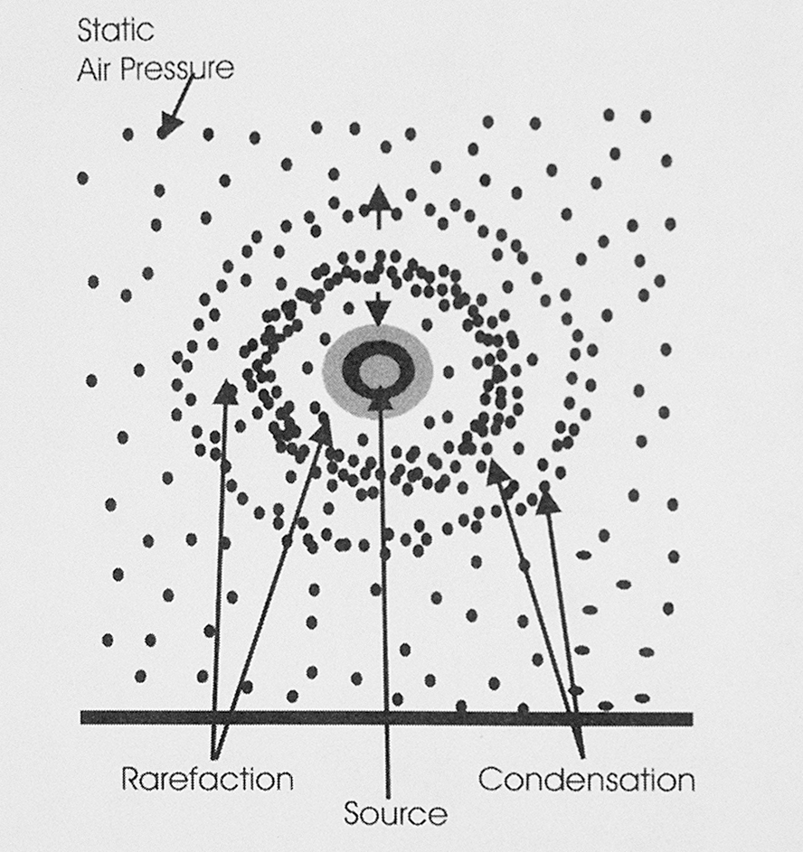

Slide 7
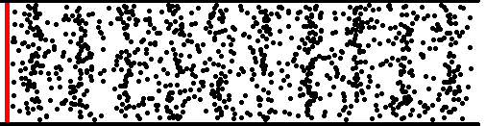
Sound is mediated by vibrating particles in gas, fluids and solids.
Sound pressure waves consist of condensation and rarefaction of particles in the air
condensation
rarefaction

Slide 8
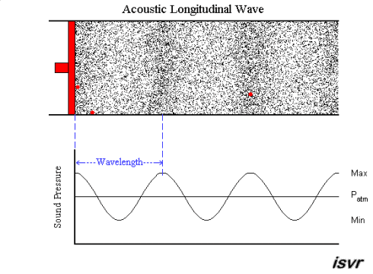
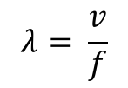
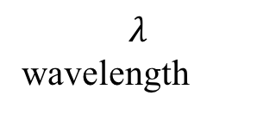
Longitudinal sound wave
$$λ$$
wavelength
$$λ= \frac{v}{f}$$

Slide 9
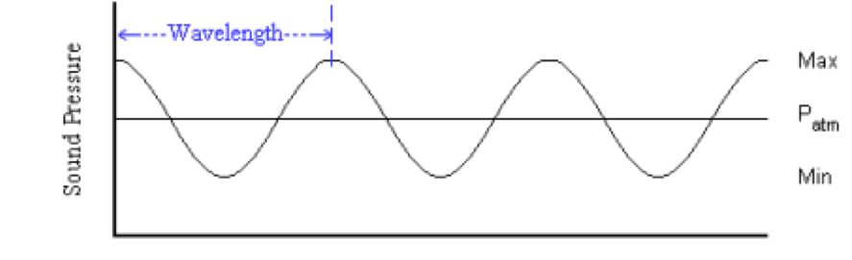
Measurements of sound pressure levels
Sound pressure levels are measured in terms of the pressure difference around the atmospheric pressure
P(x) = P_{atm} + p(x)
Average pressure Patm = 1 atm = 10⁵ Pa [N/m²]
Notes:
http://newt.phys.unsw.edu.au/jw/dBNoFlash.html

Slide 10
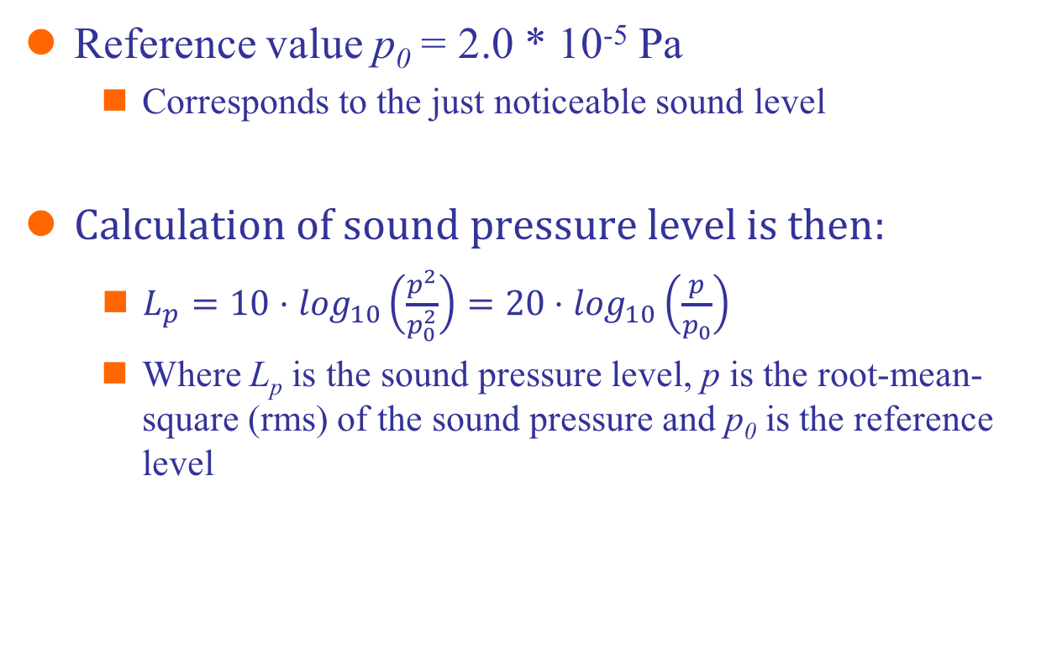
… and express it against a reference value
Reference value p₀ = 2.0 * 10⁻⁵ Pa
Corresponds to the just noticeable sound level
Calculation of sound pressure level is then:
$L_{p}=10⋅\log_{10}\left(\frac{p^{2}}{p_{0}^{2}}\right)=20⋅\log_{10}\left(\frac{p}{p_{0}}\right)$
Where L_{p} is the sound pressure level, p is the root-mean-square (rms) of the sound pressure and p₀ is the reference level

Slide 11
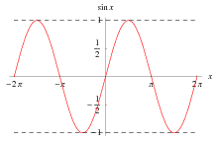
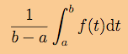
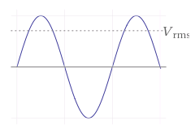
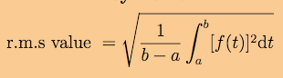
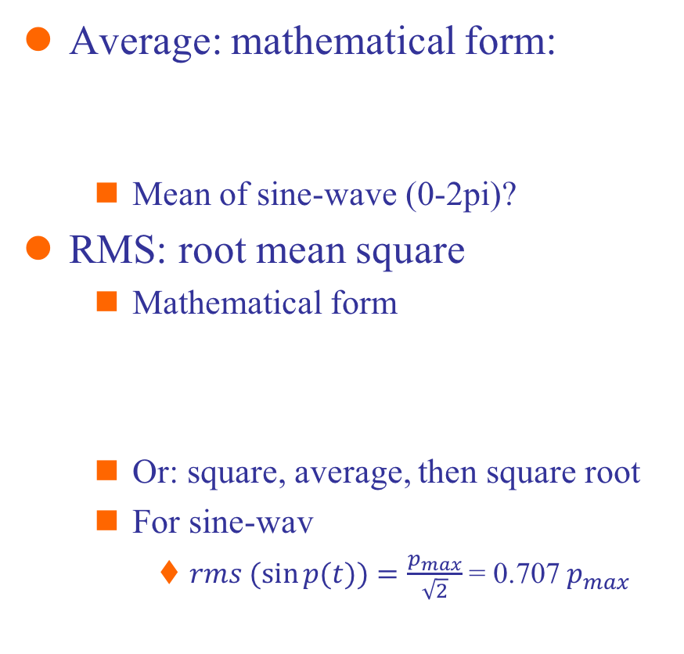
Interim: RMS
Average: mathematical form:
Mean of sine-wave (0-2pi)?
RMS: root mean square
Mathematical form
Or: square, average, then square root
For sine-wav
$rms (\sin{p(t)})=\frac{p_{max}}{\sqrt{2}}$ = 0.707 $p_{max}$
Notes:
http://www3.ul.ie/~mlc/support/Loughborough%20website/chap15/15_6.pdf

Slide 12
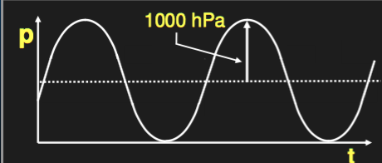
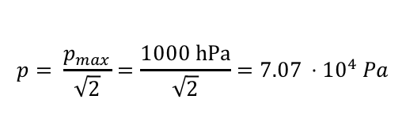
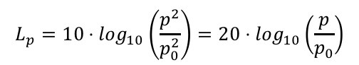
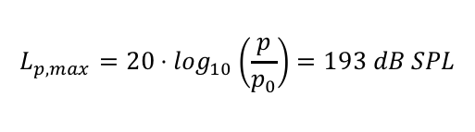
Q: Loudest sound possible?
$$p= \frac{p_{max}}{\sqrt{2}}=\frac{1000 hPa}{\sqrt{2}}=7.07 ⋅{10}^{4} Pa$$
$$L_{p}=10⋅\log_{10}\left(\frac{p^{2}}{p_{0}^{2}}\right)=20⋅\log_{10}\left(\frac{p}{p_{0}}\right)$$
$$L_{p,max}=20⋅\log_{10}\left(\frac{p}{p_{0}}\right)=193 dB SPL$$

Slide 13
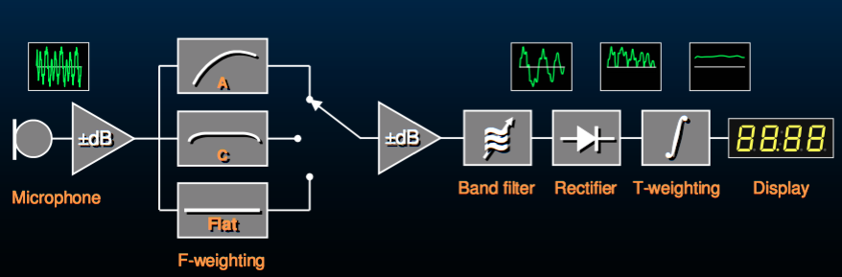
Measuring sound – sound level meter
Measure sound pressure level
Weighting with filter (user-setting)
Divide in frequency bands (if used in spectral mode)
Rectify signal (see comparison with square?)
Running average with certain time-base
Display

Slide 14
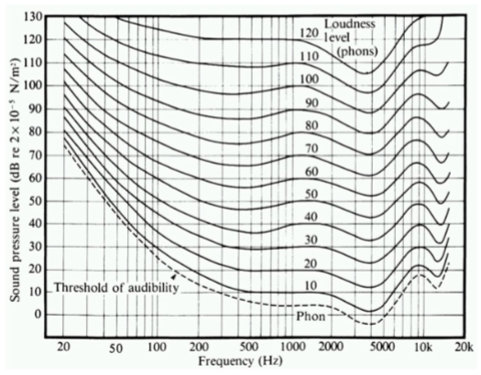
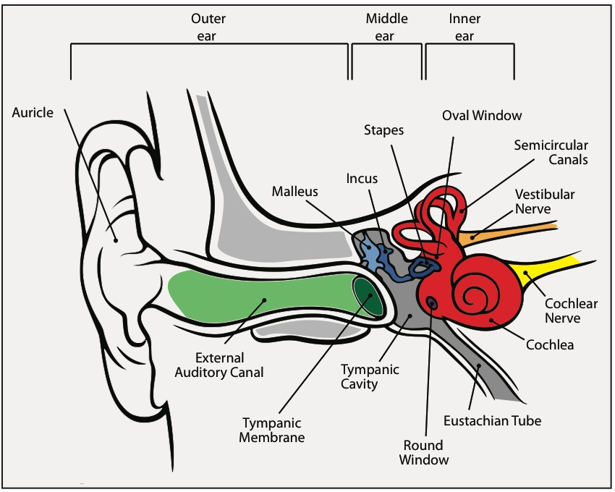

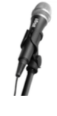
Human sensitivity to sound – minimum audible field (MAF)
Equal loudness contours as function of frequency for different loudness levels (Phons)
Notes:
Link from dB SPL to dB HL: Fletcher, H. and Munson, W.A. (1933) J.Acoust.Soc.Am. 6:59.

Slide 15
Equal loudness contours
High levels: more flat
C-weighting
Around threshold:
Lots of frequency dependent variation
A-weighting

Slide 16
The ear anatomy & function
Part 2.

Slide 17
Notes:
http://irs.ub.rug.nl/ppn/325781923

Slide 18
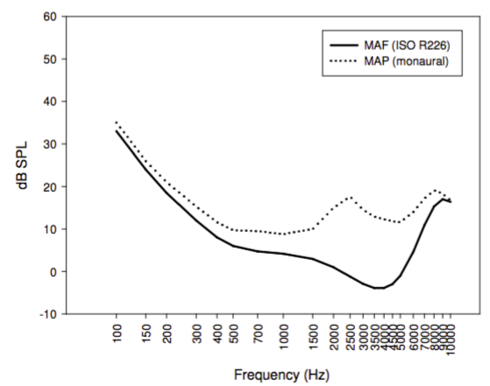
The outer ear: difference between dB SPL and HL
MAP: minimum audible pressure
Pressure measured near ear
MAF: minimum audible field
0 dB HL = MAP
Killion, 1978
Notes:
Killion, M.C., 1978. Revised estimate of minimum audible pressure: where is the “missing 6 dB”? The Journal of the Acoustical Society of America, 63(5), pp.1501–8. Available at: http://www.ncbi.nlm.nih.gov/pubmed/690329.

Slide 19
Acoustics of the outer ear

Slide 20
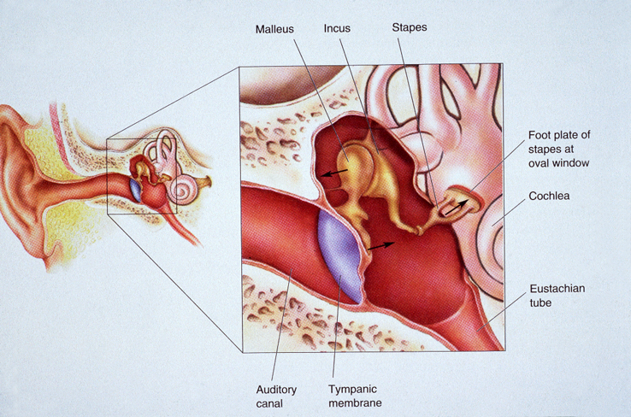
The middle ear

Slide 21
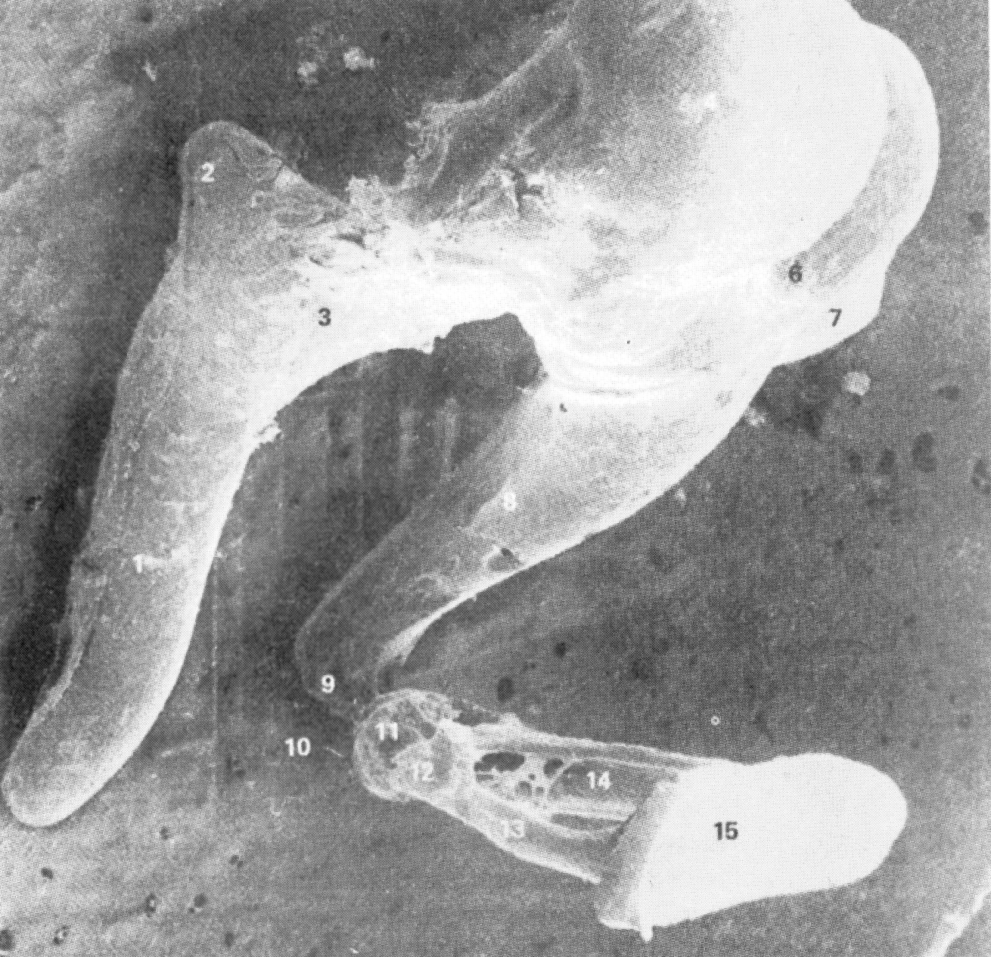
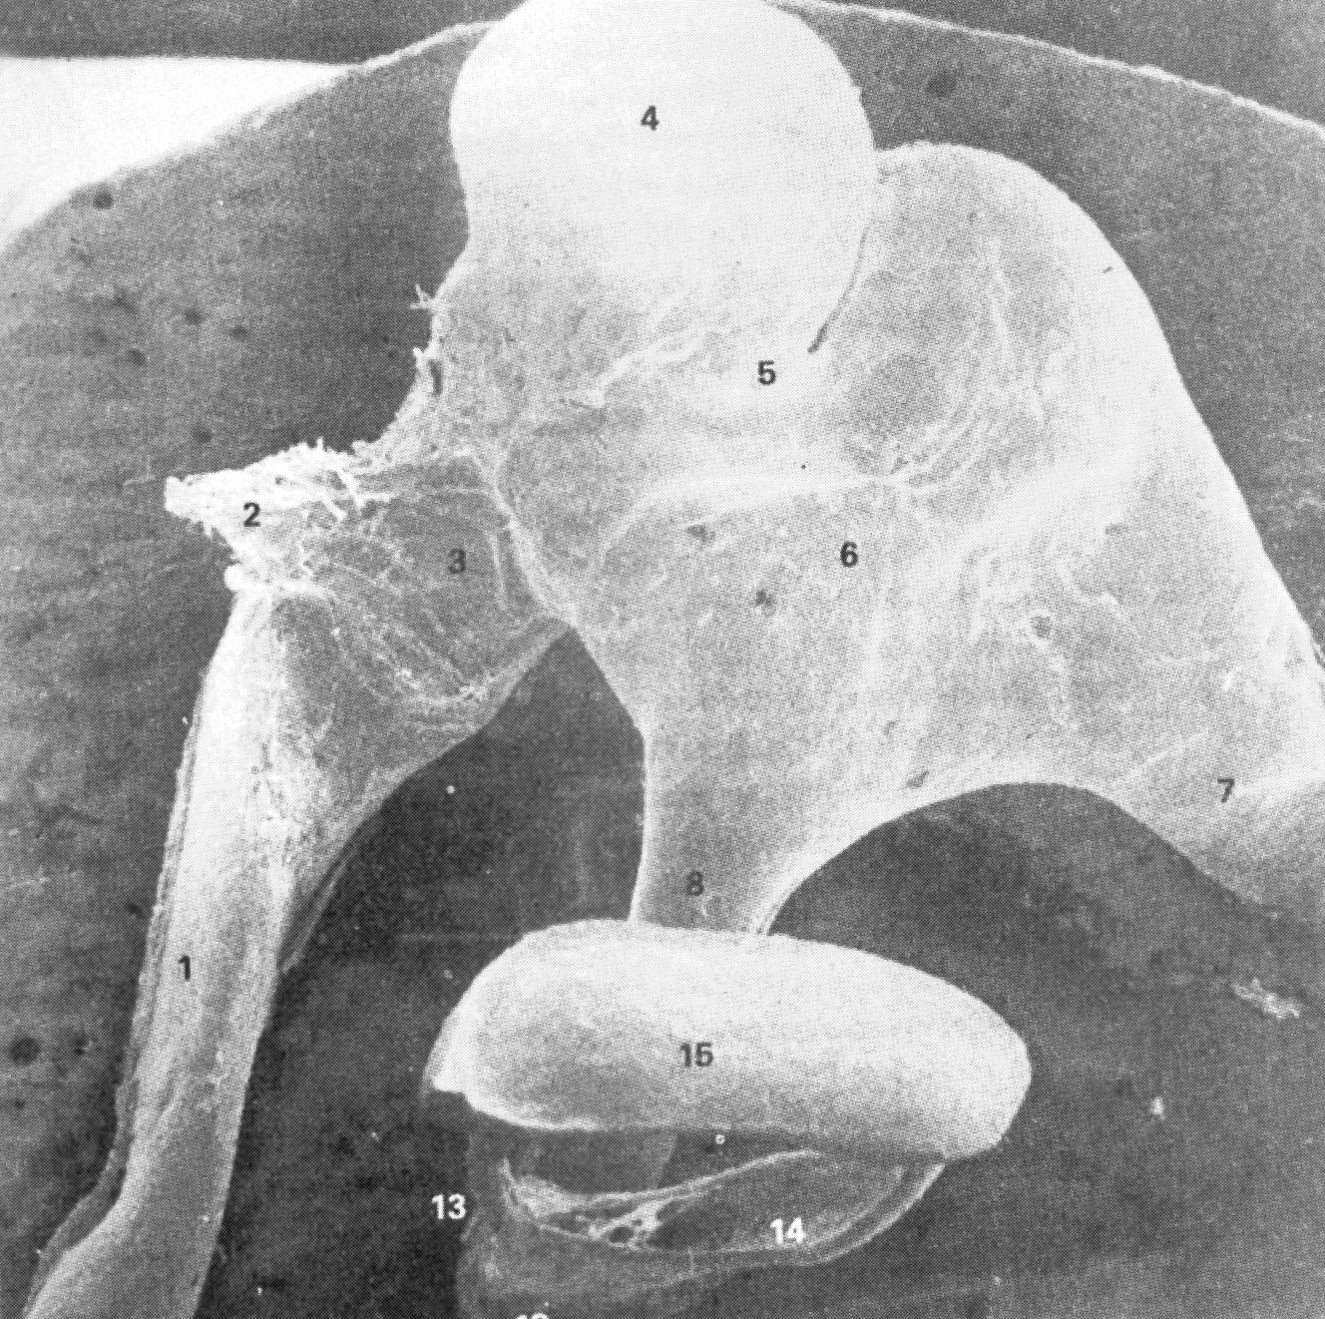
Middle ear ossicles: Hammer, Anvil, Stirrup
5 mm
Notes:
http://www.scientificamerican.com/article/experts-how-do-the-hammer-anvil-a/

Slide 22
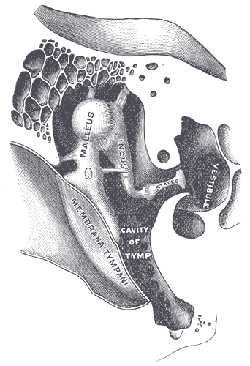
Middle ear function
Inner ear filled with fluid; it takes a lot of pressure to move particle in fluid than in gas
Middle ear ossicles provide amplification of pressure by leverage
Area of eardrum compared to oval window
Leverage provided by the orientation of the bones
Notes:
See: http://www.d.umn.edu/~jfitzake/Lectures/DMED/InnerEar/CochlearPhysiology/MEImpedanceMatching.html
Figure from Wikipedia (Gray966)

Slide 23
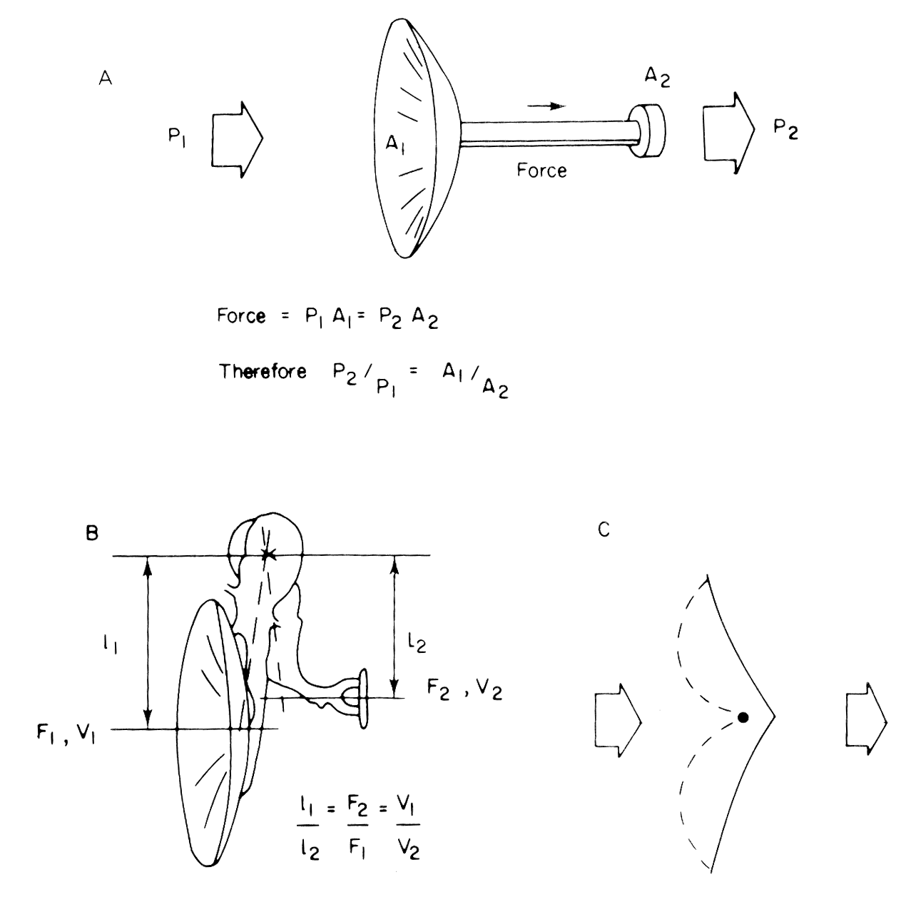
17x
Total: 17x1.3x2 = 44.2x pressure gain
10 log(44.2²) = 33 dB theoretical gain
1.3x
2x
Notes:
https://www.youtube.com/watch?v=0jyxhozq89g

Slide 24
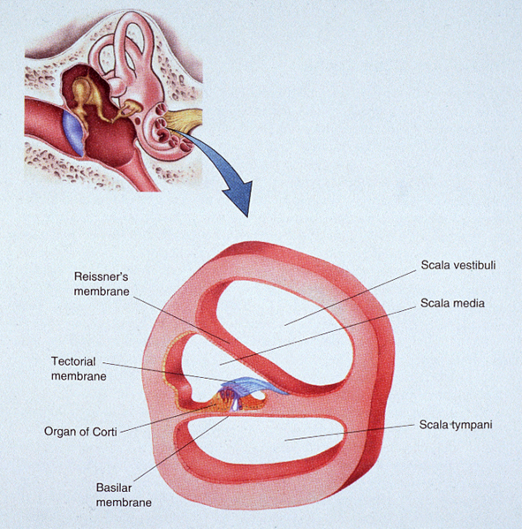
perilymph
Oval
window
Endolymph
Organ van Corti
Round
window

Slide 25
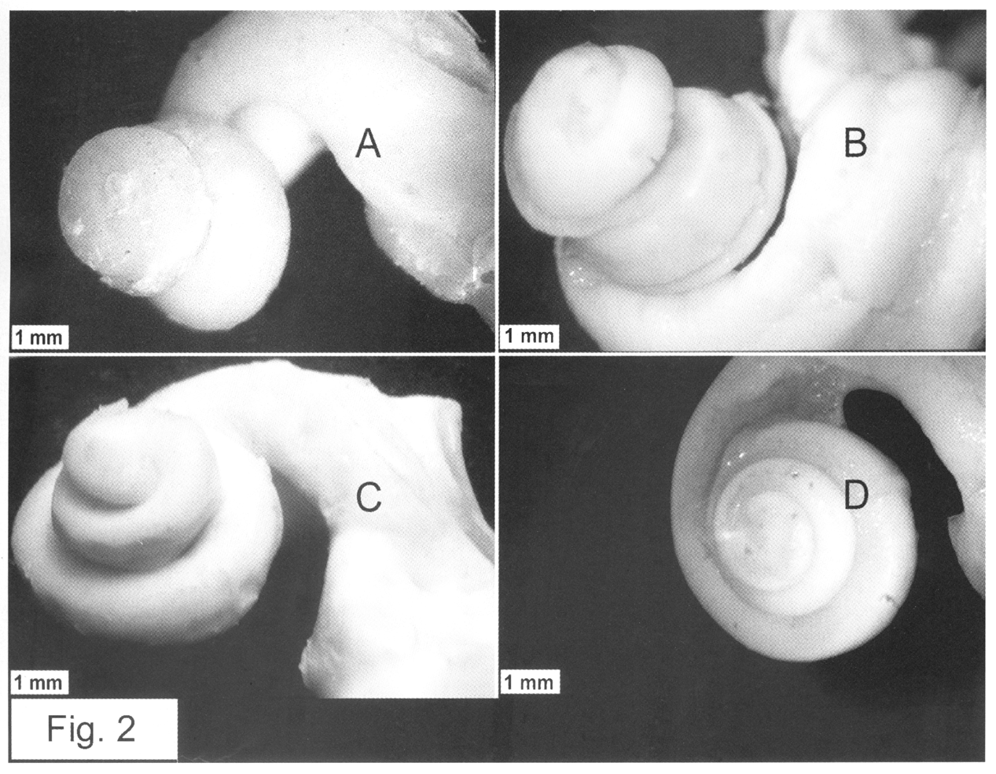
Binnenoor, slakkenhuis, cochlea
Kat
Hond
Rund
Aap

Slide 26
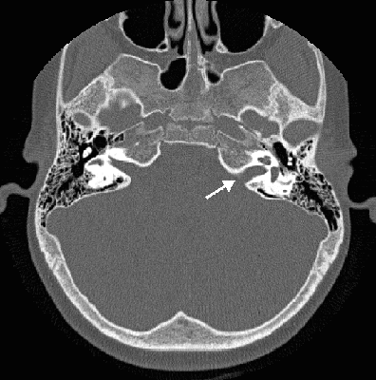
CT-scan
Human cochlea:
2¹/₂ windings

Slide 27
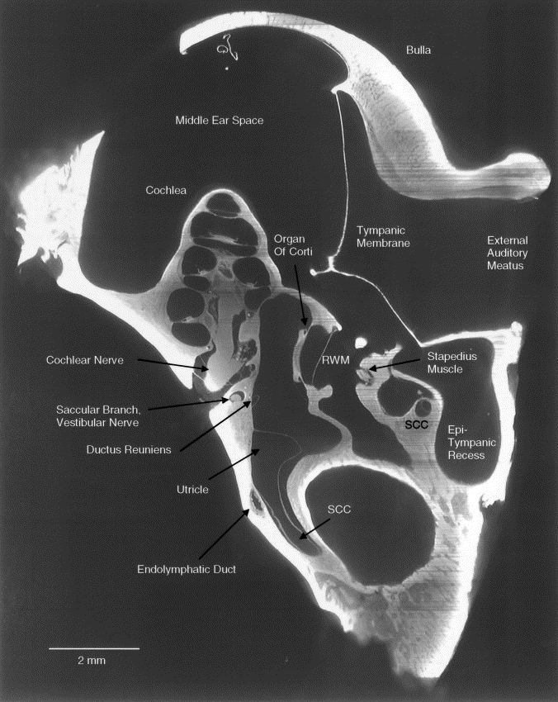
Voie (Hear. Res. 2002, 171, 119-128). Guinea pig ear with OPFOS imaging technique.

Slide 28
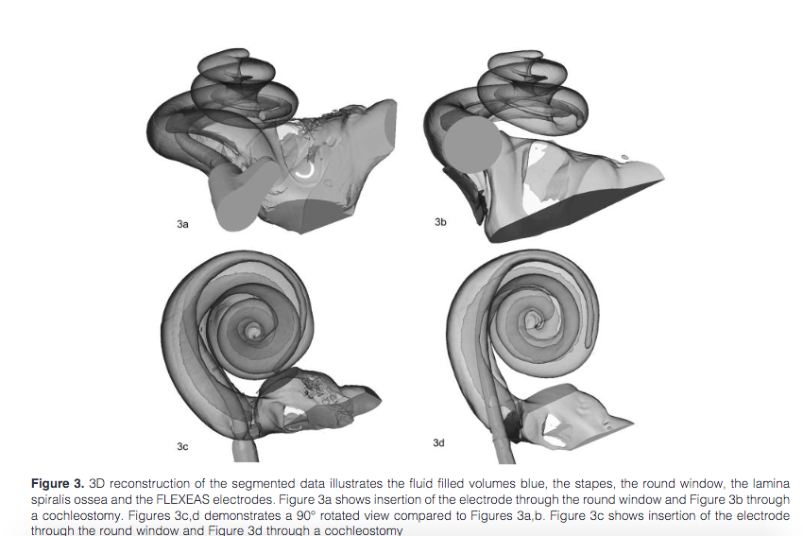
3D-reconstruction
Notes:
http://www.advancedotology.org/sayilar/73/buyuk/IAOJan2012p123-129.pdf

Slide 29
Voie (Hear. Res. 2002, 171, 119-128). Guinea pig ear with OPFOS imaging technique.

Slide 30
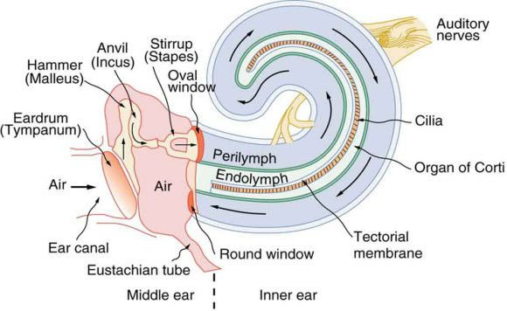
From the middle ear to the inner ear

Slide 31
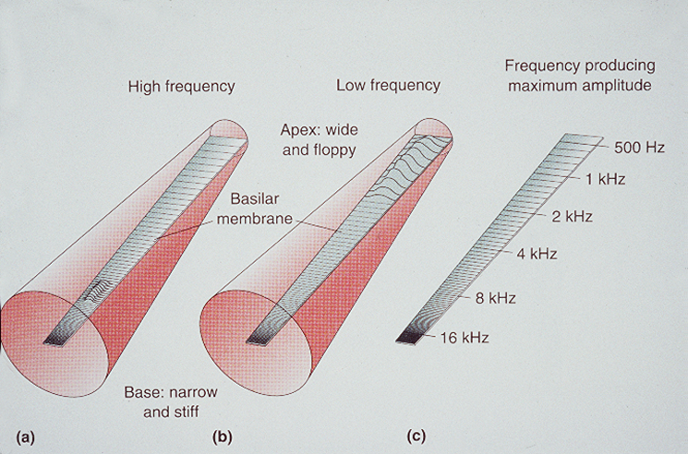
Tonotopy

Slide 32
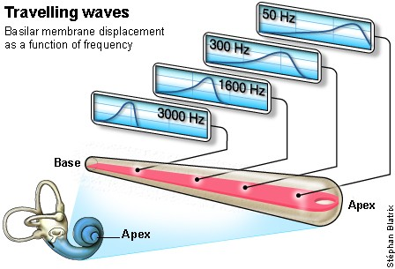
Tonotopy
Notes:
http://www.cochlea.eu/en/cochlea/function

Slide 33
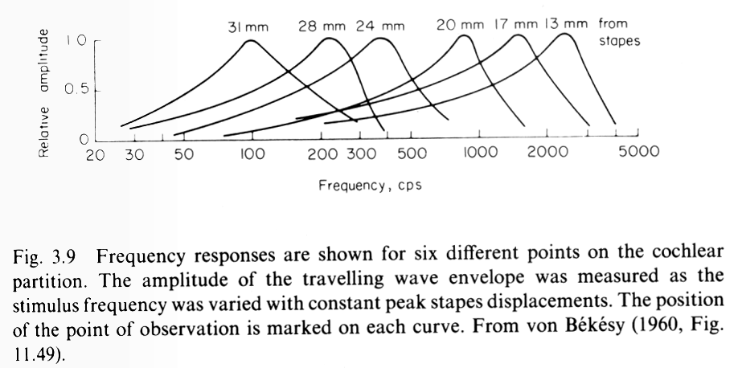
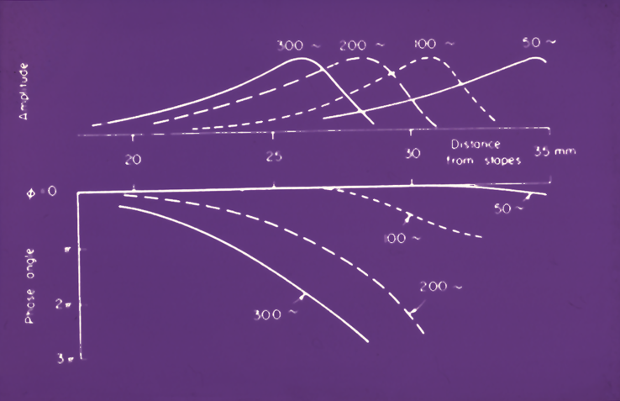
Von Bekesy (1960)

Slide 34
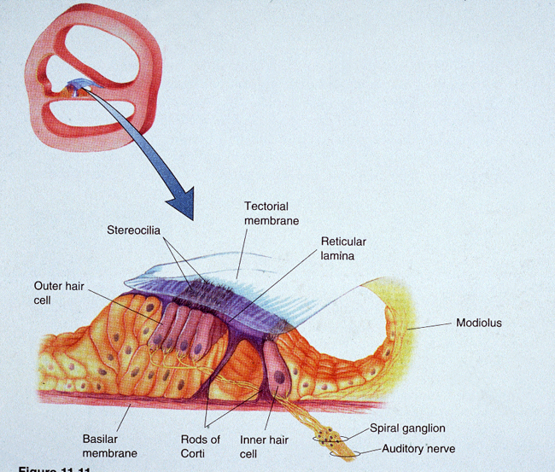

Slide 36
Organ of Cortic (anatomy)
The organ of corti is the hearing sense organ and lies on the BM
It consists of supporting cells and hair cells
2 groups of hair cells: inner and outer hair cells
IHCs
OHCs
Protruding from each hair cell are hairs called stereocilia
The tectorial membrane lies above the stereocilia –shearing motion between BM and tectorial membrane – causes stereocilia to be displaced
Notes:
www.csis.ul.ie/ccmcm/cs5611/Riana/PsychoacLect2.ppt

Slide 37
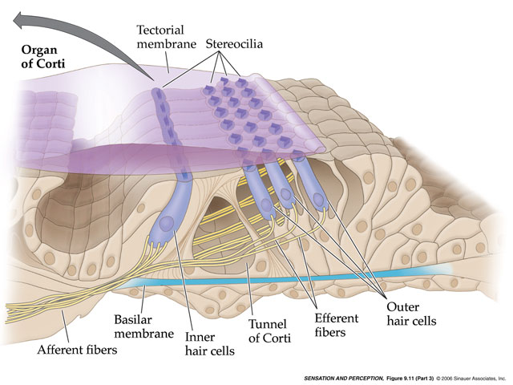
Notes:
Note: different orientation

Slide 38
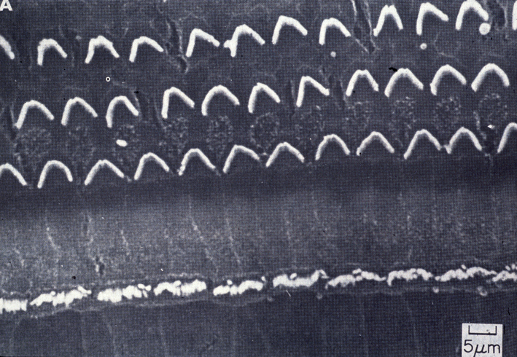

Slide 39
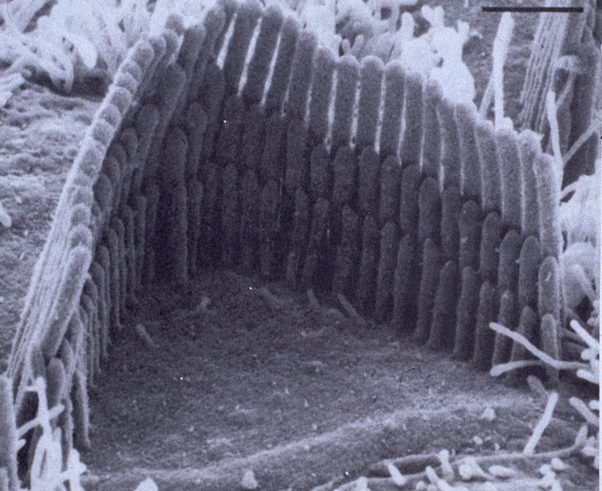

Slide 40
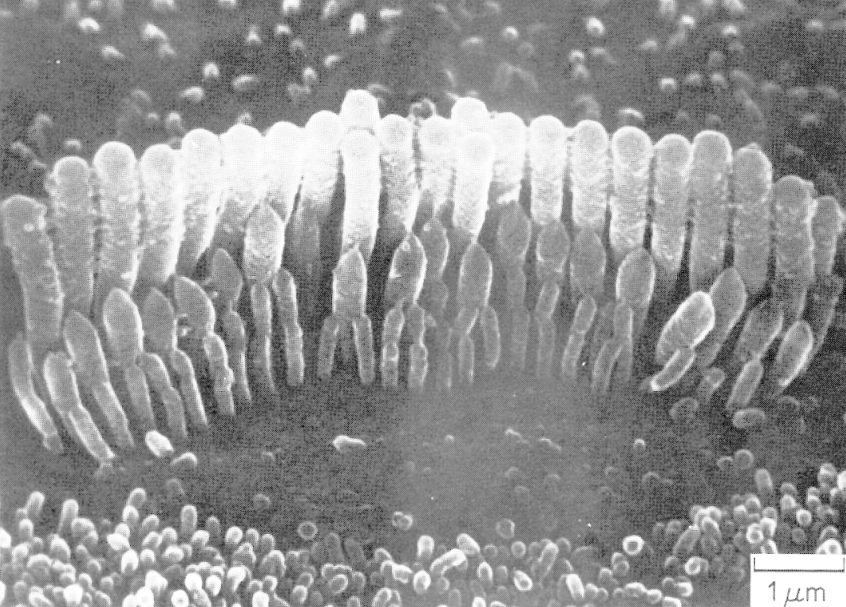
Binnenste haarcel

Slide 41
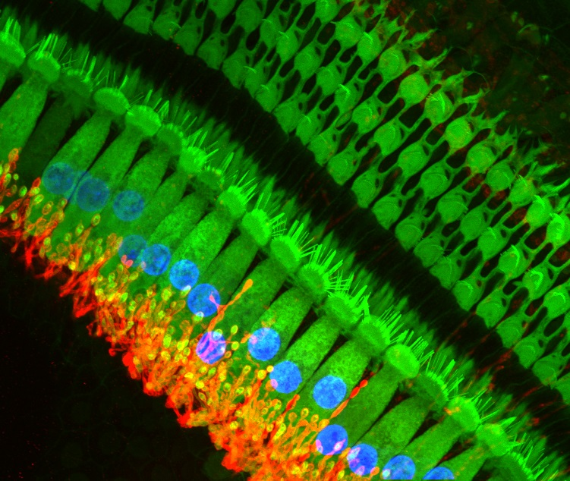
Hair cells and cell bodies confocal microscopy
Green:
Hair cells
Red: spiral ganglion cell bodies
Blue: cell bodies
Notes:
Source:
The vertebrate cochlea is responsible for transducing a mechanical stimulus, sound, into a synaptic signal that is relayed via the spiral ganglion cells to the brain. The auditory hair cells are the specialized sensory cells that mediate transduction. They do this by virtue of their specialized morphology, with actin-rich stereocilia that are sensitive to mechanical perturbation on their apical pole and robust innervation from the spiral ganglion cells on their basal pole. This micrograph uses confocal microscopy to visualize these essential components in the pathway of sound transduction in the rat cochlea. Hair cells (green) are labeled using a combination of fluorescently conjugated phalloidin (marking the actin-rich stereocilia) and an antibody against calretinin (a cytosolic calcium buffer enriched in the cytoplasm of sensory hair cells) to label the stereocilia and cell bodies. The afferent processes of the spiral ganglion cell bodies (red) are labeled using an antibody against a transporter, the Na,K-ATPase α3, enriched in the membrane of these processes. Each hair cell is approximately 10 µm wide.
Sonja Pyott; http://thepyottlab.com/

Slide 42
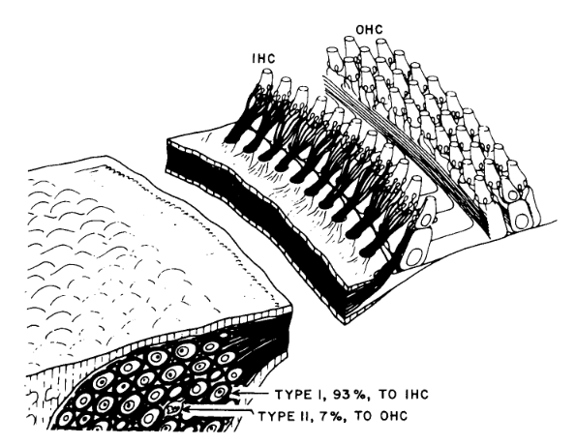
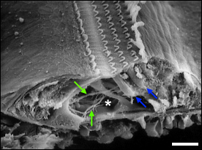
IHCs & OHCs
Scanning Electron Microscopy

Slide 43
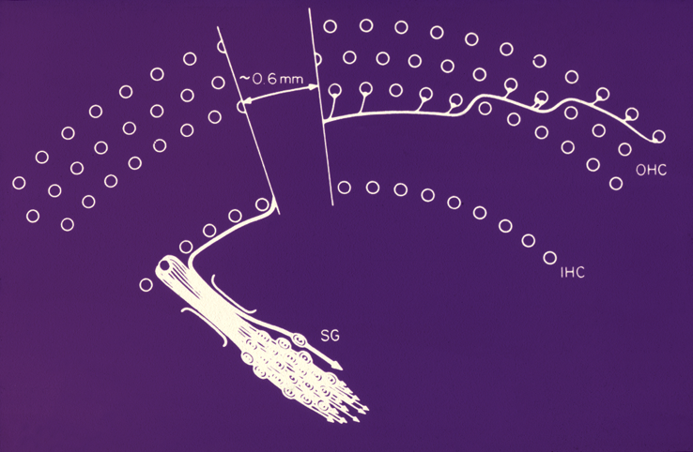
Afferent innervation (inner ear to the brain)

Slide 44
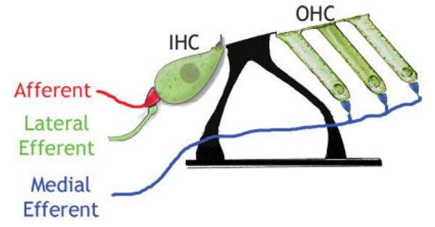
Innervation of the cochlea
Afferent: 50.000 neurons (cat), 30.000 (mens)
90-95% IHC
5-10% OHC
Efferent: 1800 neurons
±1000 IHC
±800 OHC

Slide 45
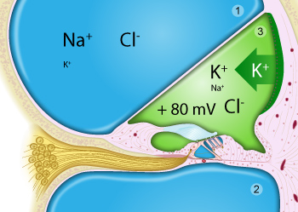
Chemical organization in the cochlear

Slide 46
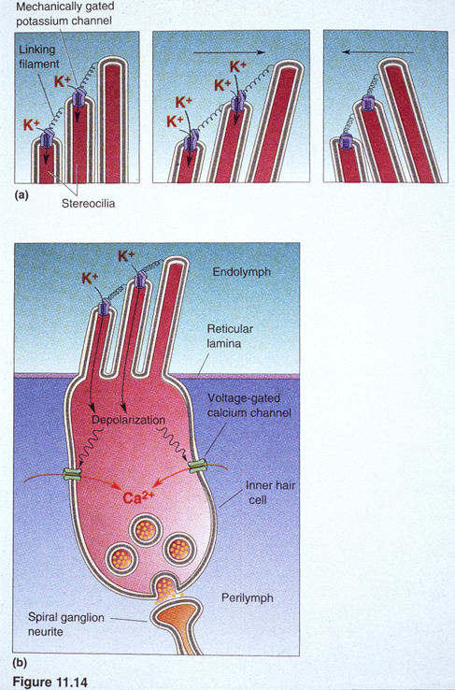
Inner hair cell function
Function is to convert BM mechanical movement into neural activity – achieved in the following way (Moore, 2004):
The stereocilia are joined by fine links called ‘tip links’.
Deflection of the stereocilia leads to the opening of “transduction channels”.
Flow of potassium ions into the hair cell – voltage difference between the inside and outside of the hair cell.

Slide 47
Inner hair cells (IHCs)
Causes the release of neurotransmitter and the initiation of action potentials in the neurons of the audtiory nerve.
Action potential – ‘firing’ of a neuron. Propagation is in one direction only down the length of the axon
Most of the afferent neurons make contact with the inner hair cells
Possibly all information about the input sound is conveyed via the inner hair cells

Slide 48
Outer hair cells (OHCs)
Have a role in achieving high sensitivity and sharp tuning
Most of the efferent neurons synapse directly with the outer hair cells
Efferent neurons carry information from higher auditory system to cochlea
Afferent neurons carry information from the cochlea to the higher auditory system

Slide 49
Function IHCs & OHCs
Inner hair cells: transduction of movement into action potentials > APs to the CNS via auditory nerve
Outer hair cells: movement of the BM causes modulation of currents in OHCs
Mechanical transduction of currents causes length change of OHCs
This modulates movement of tectorial membrane; amplifies existing motion

Slide 50
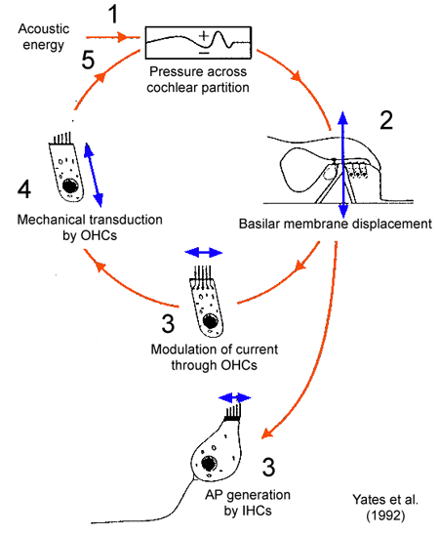
OHCs and IHCs
Stebbins et al., Am J Otolaryngol. 1979 Fall;1(1):15-27.
Notes:
http://www.d.umn.edu/~jfitzake/Lectures/UndergradPharmacy/SensoryPhysiology/Audition/OHCFunction.html
See also: http://www.d.umn.edu/~jfitzake/Lectures/DMED/InnerEar/CochlearPhysiology/ActiveProcess.html

Slide 51
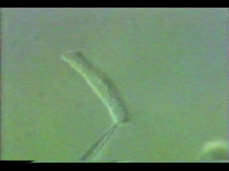
Length changes of outer hair cells
Notes:
https://www.youtube.com/watch?v=Xo9bwQuYrRo

Slide 52

Passive and active cochlea
Yoon et al., Biophys (2011)
Notes:
Differences in active and passive cochlea are remarkable:
From: http://www.ncbi.nlm.nih.gov/pmc/articles/PMC3010833/; figure 3
Passive (light solid lines) and active (heavy solid lines) models of basilar membrane velocity (V_{BM}) relative to stapes velocity (V_{ST}) magnitude (upper row) and corresponding phase (lower row) for the gerbil, chinchilla, cat, and human cochleae. Passive (open squares) and active (asterisks) experimental data are included for comparison with gerbil (100 dB SPL input for passive and 30–40 dB SPL for active) (11) and for chinchilla (90 dB SPL for passive and 10–20 dB SPL for active) (12). Thick black circles mark the BF corresponding to the passive case. Details of the simulation parameters are in Table 1.

Slide 53
Diagnostic testing
Part 3

Slide 54
Objective methods
Otoacoustic emission (OAEs)
What are OAEs
Auditory Brainstem Responses (ABR)

Slide 55

Brainstem / BERA
Audiogram
tymp
ASSR
OAE

Slide 56
Recap active mechanisms in cochlea
De buitenste haarcellen (OHC) zijn in staat geluid te genereren, meetbaar als OAEs
- Wat als OHC verlies optreedt?
- En de binnenste haarcellen (IHCs) dan?
OHC verlies: drempels > 50 dB
IHC verlies: drempels > 120 dB
Het ontbreken van OAEs (zoals in veel volwassenen met een goed gehoor) is geen ‘bewijs’ voor gehoorverlies!
Andersom: het meten van OAEs wijst wel op goed werkende cochlea (OHCs)

Slide 57
OAEs
Based on active mechanism of amplification by the OHCs
Instability of forward-gain causes emissions
First described by Kemp (1977 & 1978)
But predicted by Gold (1948!)
Low-level sounds produced by the cochlea and recordable in the external ear canal.
Various forms:
Spontaneous
Click-evoked
Distortion Product
Stimulus Frequency

Slide 58

Click-evoked OAE

Slide 59

TEOAE bij een pasgeborene
Notes:
Test: wit; retest: geel; alternerend gemiddeld (1,3,5,7 = test; 2,4,6,8 = retest)
reproduceerbaarheid van de responsies: correlatiecoeffiecient.

Slide 60

Distortion-product emissions

Slide 61

Example of distortion-product emission

Slide 62


DPOAE
f1 = 3838 Hz
f2 = 3164 Hz
2*f1 – f2 = 2500 Hz
Notes:
http://www.d.umn.edu/~jfitzake/Lectures/DMED/InnerEar/CochlearPhysiology/OAE.html

Slide 63

OAE as Measure of Cochlear Health

Slide 64

ABR
EEG measurement of auditory brainstem response
Averaged response to click-stimuli
Pattern of responses used to determine hearing threshold

Slide 65

Brainstem Evoked Response Audiometry
Stimulus: clicks
Click-synchroon meten van electrische signalen
Signaal middelen

Slide 66

Origins
Notes:
https://pharmaceuticalintelligence.files.wordpress.com/2015/02/the-auditory-pathway-and-normal-auditory-brainstem-response-abr.jpg

Slide 67

ABR example

Slide 68


Slide 69

Rehabilitation
Conventional hearing aids
Amplify sound and present them at the eardrum
Usage: conductive and perceptive hearing loss
Various forms

Slide 70

Rehabilitation
Bone conduction devices
Bypasses the middle ear
Useful with conductive hearing loss
Middle-ear problems: chain luxation, no chain, cholesteatoma

Slide 71

Rehabilitation
Cochlear implants
Bypasses IHCs
Stimulates Spiral ganglion cells

Slide 72

CI coding

Slide 73
Peoples response
https://www.youtube.com/watch?v=mbe7x8GP2Ds

Slide 74
Now…
You should be able to
name different parts of the ear, name and explain their function
Explain the transduction from sound to action potentials
Explain how bone-conduction may help rehabilitation
Explain how the size and shape of an organism affects their sensitivity to sound (and vocalizations)
How objective measurements can be used to diagnose hearing
What types of rehabilitation exist and how they work

